Slide 1
HCI Theory – Applying Situated Action
Online Ethnography

Slide 2

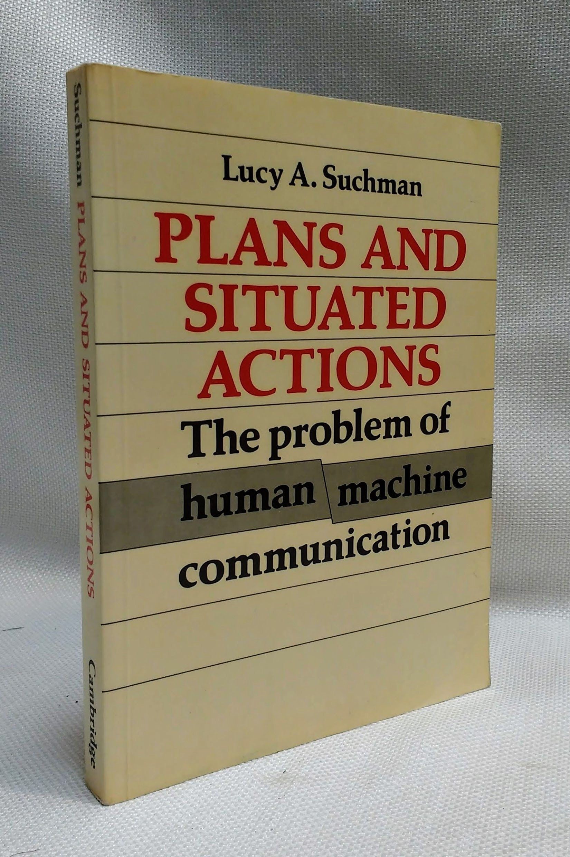
What is Situated Action
An approach developed by Lucy Suchman
Lucy Suchman
Situated Action is not a theory or a framework
-
-
though sits within the tradition of Situated Cognition Seminal work: Plans and Situated Actions: The Problem of Human-machine Communication (1987)
A broad insight into the importance of the specifics of context to interaction
Actions are “situated” not planned… Meanings of actions stem from the situation in which they occur

Slide 3
Methods for Situated Action
You can only study action by observation in the real world
-
-
Rich descriptions are preferred over generalisable theories Lab studies are seen as abstracted non-ecological (removed from the ecology which gives rise to actions)
Behavioural Observation:
-
-
-
-
-
Record behaviours and conversations Follow user to study their actions Trace artefacts
Capture interactions
Study the same tasks in diﬀerent contexts

Slide 4
Ethnography
Roots in anthropology
Original aim to document “primitive cultures”
E.g., Bronisław Malinowski and the Trobriand Islanders
Ethnography as a “way of seeing”
Notes:
-It’s an approach to carrying out field work
Malinowski and others began to carry out expeditions to study cultures in far-away lands
- Went to Australia and Pacific Islands
- Stranded for 4 years by outbreak of WW1
- collected 3 kinds of data: charts of relationships between institutions, customs and activities, detailed descriptions of day-to-day life; stories, narratives, myths, magic through which the society represents itself and the outside world
-Argonauts of the Western Pacific: functional analysis of the Kula ring, system of ceremonial gift exchange. -Explained in terms of social cohesion: central problem of all societies.

Slide 5
Digital/Online Ethnography
“Digital Ethno is the modern, digital equivalent of traditional, Malinowskian ethnographic forms. The critical distinction is that while traditional ethnographers physically immerse themselves in distinct places and their cultures, digital ethnographers capitalize on wired and wireless technologies to extend classic ethnographic methods, like participant observation, beyond geographic, as well as temporal, boundaries.”
Masten, D. L., & Plowman, T. M. (2003). Digital ethnography: The next wave in understanding the consumer experience. Design Management Journal (Former Series), 14(2), 75-81.

Slide 6
Group Work – Online Ethnography (Light)

Slide 7
Case Studies
Amazon Alexa
  https://www.reddit.com/r/alexa/
Google Home
  https://www.reddit.com/r/googlehome/
Smart Home
  https://www.reddit.com/r/smarthome/
Home Automation
  https://www.reddit.com/r/homeautomation/

Slide 8

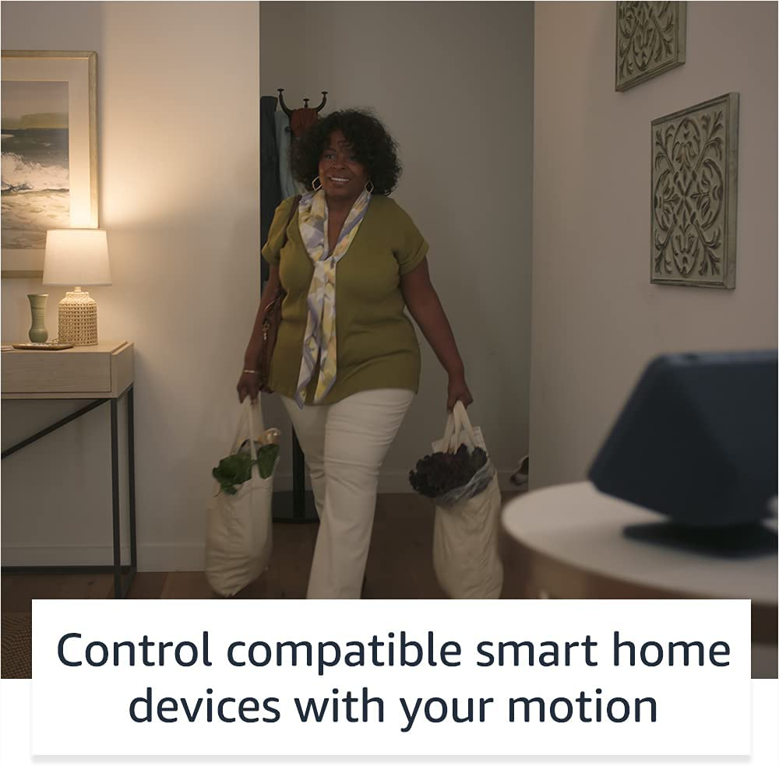
Amazon Alexa

Slide 9
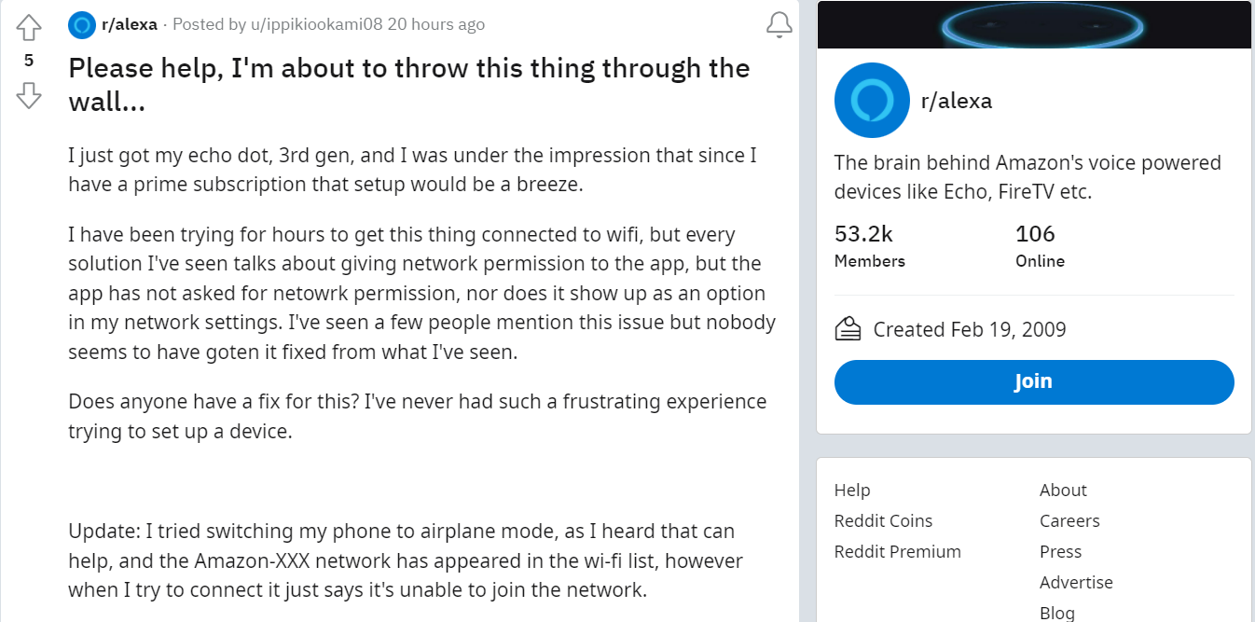
r/alexa – “frustrating experience”

Slide 10
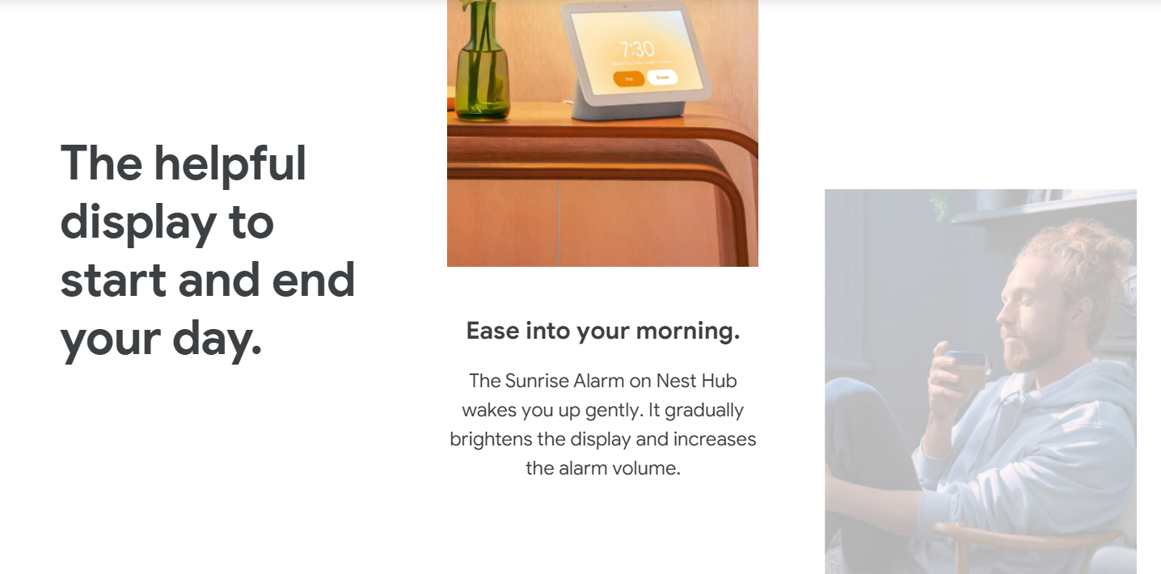
Google Home

Slide 11
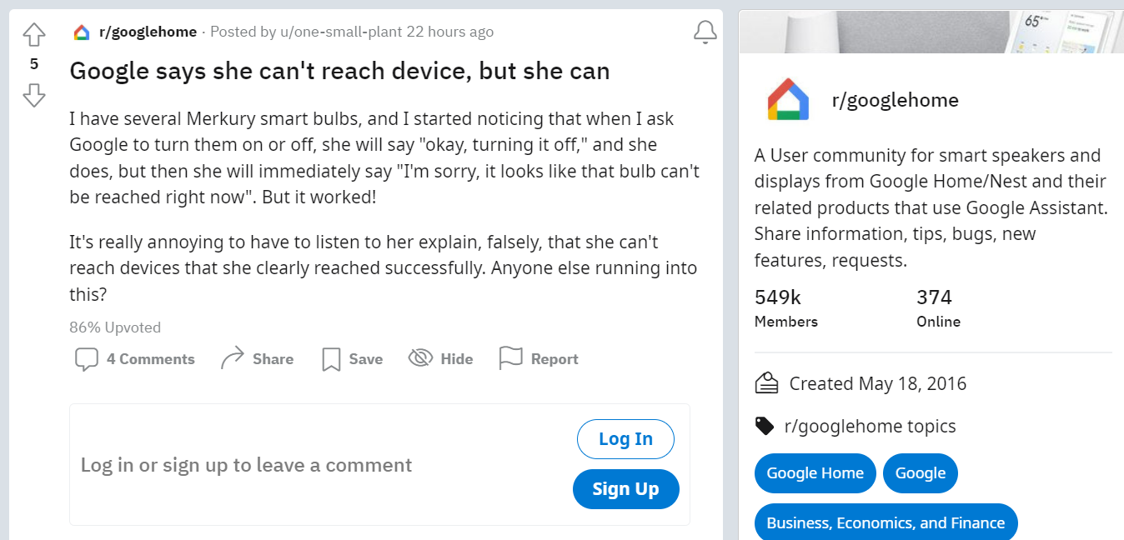
r/googlehome – “she”

Slide 12
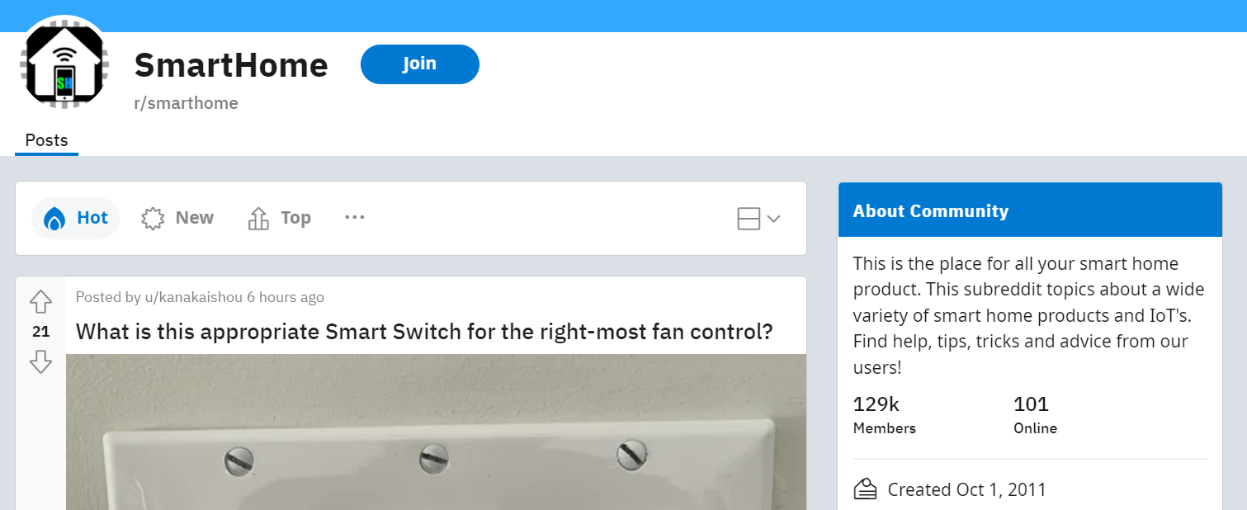
SmartHome

Slide 13

r/smarthome –”dummies” & “65+” devices

Slide 14

Home Automation

Slide 15
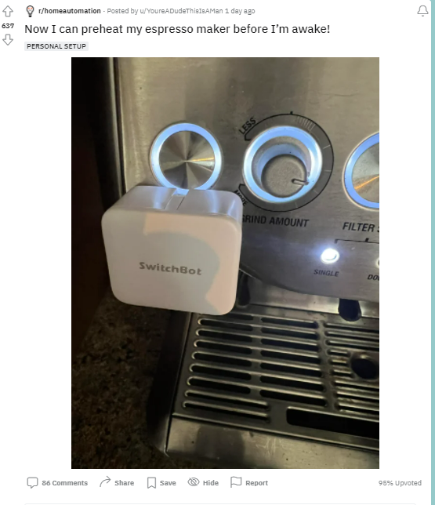
r/homeautomation
--not a new machine but a hacked mechanical machine

Slide 16
Group Work Activity
Learn more about a domestic technology or a domestic technology community by conducting a focused online ethnography on Reddit
Choose either r/alexa, r/googlehome, r/smarthome, r/homeautomation to analyse
Use three slides (e.g. pptx) to document interesting findings
Nominate a group member to report (< 3 mins)
Upload your slidedeck to Teams>General>Files>Class Activities>Week 7
Get ready to present!

